Slide 1



Chest X-ray Abnormalities Detection

Slide 2
Kulkarni Ganesh Shivajirao
ED16B016
InuAid Solutions Pvt.Ltd
Guide : Ganapathy Krishnamurthi

Slide 3
YoloV5 Findings
Used partial classes dataset, trained 4 Yolov5 models
Used K Fold method and trained 5 Yolov5 models
Used Weighted box fusion to ensemble the results
Method | Models | Validation mAP | Kaggle Test mAP
Partial classes training | Each trained model Ensemble of 4 models | 0.32 ~ 0.35 0.41 | 0.1 ~ 0.13 0.192
K fold training | Each trained model Ensemble of 5 models | 0. 38 ~ 0.4 0.45 | 0.13~ 0.16 0.21

Slide 4
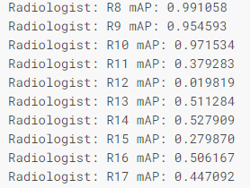
Stage 2 YoloV5
Images from R8’, ‘R9’ and ‘R10’ radiologists are removed from previous K fold dataset
Boxes was tripled using 3 variants of boxes for remaining annotations
Again trained 5 yolov5 models updated dataset
Used corresponding pretrained model as input to stage 2

Slide 5
YoloV5 Model
Batch Size 40
Image Size 640
Optimizer SGD
False Images included
No. of Classes 14 (no finding excluded)
Learning rate 0.0005

Slide 6
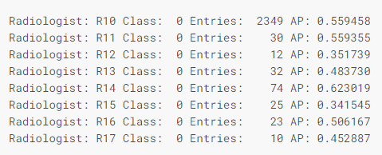
Results
Generated results using each model
Ensemble 5 results using WBF method
Method | Models | Validation mAP | Kaggle Test mAP
Stage 2 Yolov5 | Each trained model Ensemble of 5 models | 0.30 ~ 0.33 0.405 | 0.17 ~ 0.18 0.212

Slide 7
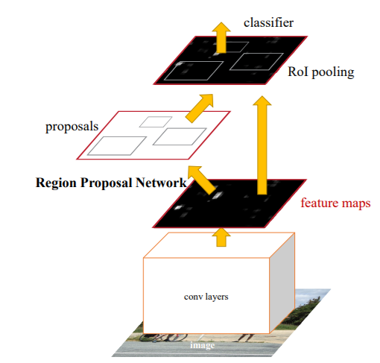
Faster RCNN
Used DICOM Images for training Faster RCNN model
Converted annotations into standard COCO format
Used Healthy images as background class
Given full boxes to negative images

Slide 8
Faster RCNN Training
Used 12000 DICOM Images for training and 3000 for Validation
Provide annotation in COCO format with json file
Used Resnet101 backbone, pretrained on ImageNet
Learning rate : 0.001
Number of classes : 15 (including background)
Batch size : 64
Images size : 512
Kept other hyperparameters as default

Slide 9
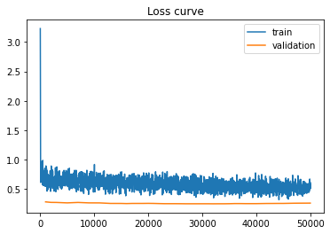
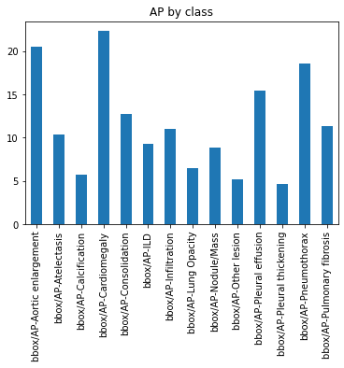
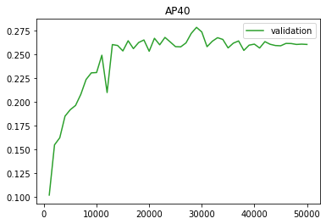
Results

Slide 10
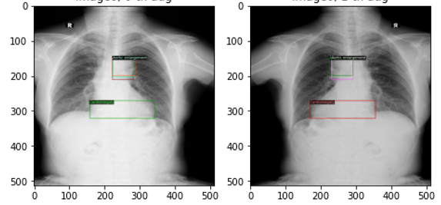
Results
Generated results of Faster RCNN
Ensemble using WBF method
Method | Models | Validation mAP | Kaggle Test mAP
Faster RCNN | Single based trained model | 0.275 | 0.185

Slide 11
Final Results
Ensembled results of YoloV5 and Faster RCNN with class based fusing
Got Rank 24 out of 1300 teams (top 2%) on in the VinBig Kaggle competition
Method | Type | Kaggle Test mAP | mAP after Ensemble
YoloV5 | Partial classes training | 0.192 | 0.279
YoloV5 | K fold training | 0.21
YoloV5 | Stage 2 training | 0.212
Faster RCNN | Single model training | 0.185

Slide 12
Thank You

